Slide 1

RETAIL ANALYSIS USING NEURAL NETWORKS
EVAL #2
Nathan Little
Colin Kirby
1
Notes:
“Hi everyone, I’m Nathan Little with Colin Kirby. Welcome to our second evaluation presentation – ‘Retail Analysis Using Neural Networks.’
“We’ve spent the last few weeks debugging and refining our object detection pipeline to improve accuracy and reliability, especially in very dense, crowded retail environments. And today, we’re excited to walk you through how we did that – what went wrong, what we fixed, and what’s working now.”

Slide 2
Table of Contents
Project Recap
Baseline Performance
Improvement Techniques
Before / After Improvements
Results Summary
SOTA Comparisons
Team & Contributions
Conclusion
2
Notes:
“Here’s a quick breakdown of what we’ll be covering today. We’ll start with a Project Recap, just to bring everyone in what we’re building and how it works. Then we’ll walk through our Baseline Performance – including some of the issues from Eval #1, and how we reset that baseline properly this time. After that, we’ll dive into the heart of today’s presentation – Improvement Techniques. We’ll cover five major updates we made to the model, why we made them, and what kind of impact they had. We’ll also show a direct Comparison between our new baseline and prior results, followed by some highlights in the Results section. We’ve also got a short Demo showing the model in action, and finally, we’ll wrap up with our Team Contributions and Conclusion.”
Let’s get started with a quick recap of the project.”

Slide 3
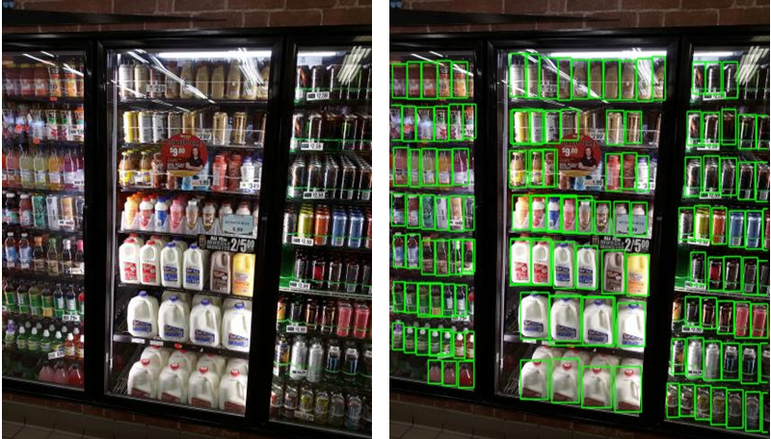








Project Recap – ShelfVision
Our Goal :
Detect & Localize retail products on shelf images.
Handle dense, cluttered scenes with overlapping objects.
Train a custom object detection model on the SKU-110K dataset.
Improve anchor coverage, training stability, and detection accuracy.
Pipeline Overview ( Simplified ) :
Left: Original image of a grocery shelf.
Right: Detected items with bounding boxes.
Source: “Retail Store Item Detection using YOLOv5”
Dataset Loader
ResNet Backbone
Feature Pyramid Network
Detection Head
Anchor Generator
Anchor Matching
Detector
Training
3
Notes:
"Our goal in this project was to detect and localize individual retail items in crowded shelf images — basically, teaching a model to draw boxes around each product. This involves working with a dense dataset called SKU-110K, where the scenes are packed, objects overlap, and accurate detection is challenging."
"To handle that, we built a custom object detection pipeline with a focus on improving anchor coverage and training stability. The diagram below gives a simplified view of how images move through our system — from loading the data, to feature extraction, to generating candidate boxes and training the model to make accurate predictions."

Slide 4
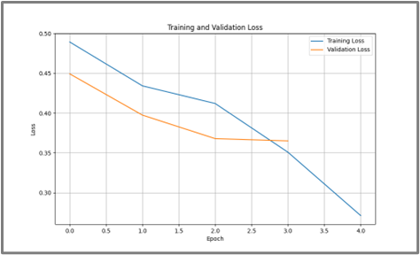

Baseline Performance : Old EVAL1
Eval #1 – Initial Set Up
Most metrics were zero or near-zero.
High box clutter, low overlap $→$ ineffective coverage.
Resulted in meaningless Precision / Recall Plots.
Goal back then : “Make anything show up.”
Why We Needed a New Baseline
Detected boxes existed, but didn’t align with objects.
We couldn’t tell if any improvement was actually an improvement.
Needed clean loss curves and IoU-based training stability.
Set up a new baseline with better anchors + loss visibility.
Figure: Old baseline loss — values unreliable due to noisy, random outputs.
4
Notes:
"Our initial setup in Eval 1 was all about just getting something to show up — the goal was simply to make the model output anything. The anchors weren’t well-aligned, and most of our metrics were either zero or so low they weren’t meaningful. We had a ton of predicted boxes, but they didn’t actually match the ground truth — or in other words, the real labeled items."
"Because of this, our loss curves didn’t reflect true learning, and precision-recall plots were basically random noise. That’s when we knew we had to reset and establish a new, more stable baseline. One with clean anchor coverage and trackable training behavior — so that any future improvements could be measured properly."

Slide 5
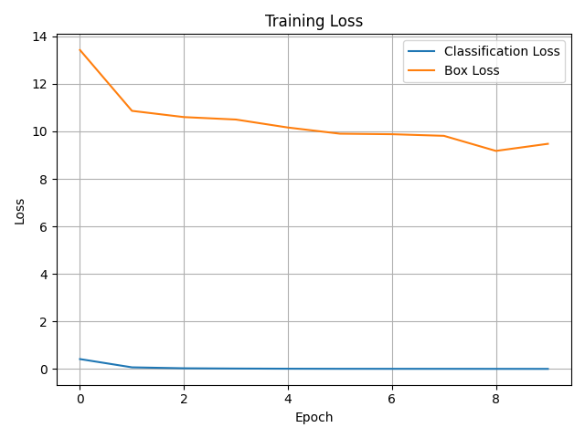
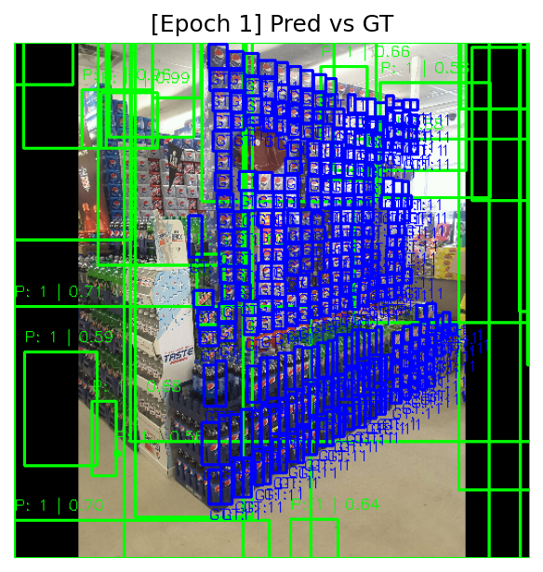
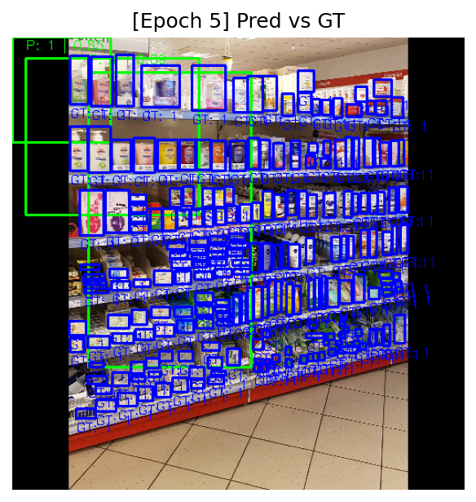
Baseline Performance : New Baseline
New Baseline – Stable Training Run
Improved architecture + better anchor tuning.
Loss trends are more meaningful :
Classification Loss : Very Low early on
Box Regression Loss : Still High, but Steadily Decreasing
Provides a solid launch point for evaluating future improvements.
Figure: New baseline training loss. Classification loss (blue) quickly drops, while box loss (orange) decreases slowly, showing potential for better localization.
5
Notes:
After the messiness of proper output in Eval 1, we ended up taking a hard rest and rebuilt with a new proper baseline.
The goal was to simplify the architecture and then scale back up from there, with a focus on the anchor generator and its ability to better align with actual object sizes.
This gave us a much better more modular training behavior that we could analyze.
You can see a major difference with the losses, even though the box loss is high in this metric its steadily going down, and it tells us that our model is learning to localize better, and even though its not really perfect yet, this set up is much more stable and gives us a much more reliable launch point to begin testing real improvements.

Slide 6

Improvement Techniques Overview
1. Anchor Tuning Fixes $→$
Adjusted anchor scales and placement to better match ground truth boxes.
2. Improved Matching Logic $→$
Rewrote anchor matching with dynamic IoU and best match assignment.
3. Box Delta Debugging $→$
Fixed errors in how predicted deltas were applied to anchors.
4. Memory & Batch Tuning $→$
Reduced batch size and added subset config to avoid crashes.
5. Loss Balancing & Schedule Optimization $→$
Reweighted losses, extended warmup, and eased LR decay for more stable training.
6
Notes:
So at this point in the project, we knew that our initial model wasn't performing well — we had almost no detections. Even though our losses were okay, our predictions were not.
To fix that, we approached the problem from five angles that covered everything from the model architecture to training stability as shown below consisting of :
Each of these techniques helped target a known bottleneck.
Together with tuning memory, batch sizes, and our training schedule, these improvements laid the foundation for actual learning to happen.

Slide 7
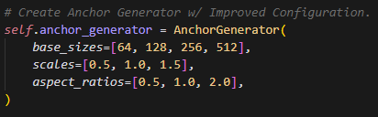
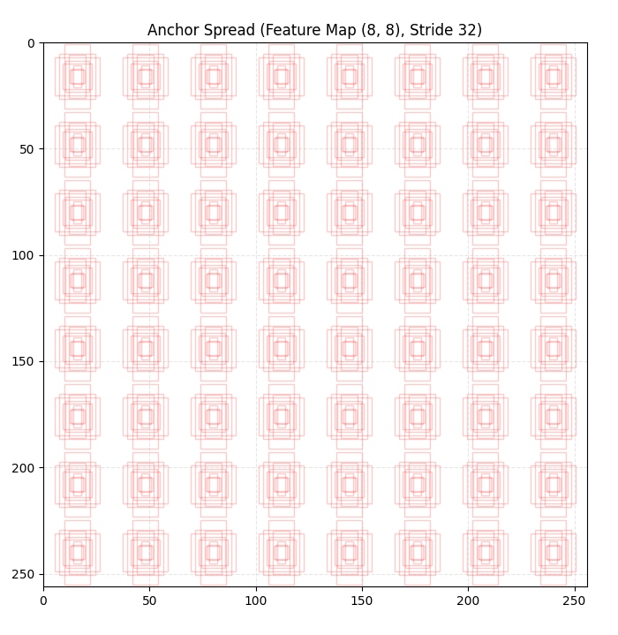
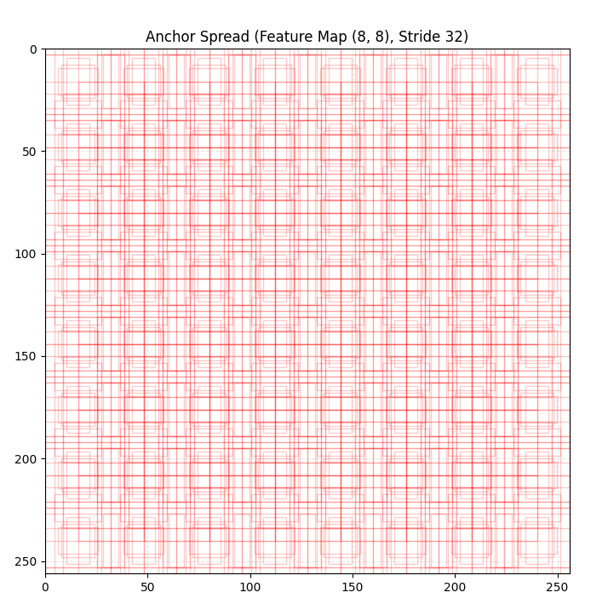

1. Anchor Tuning Fixes
The Problem :
Anchors were too small, too centered, or clipped at image edges.
Most anchors didn’t overlap with any ground truth box $→$ poor learning.
Figure: Snippet of Anchor Generator Initialization.
After Adjusting Scales & Aspect Ratios
What We Changed :
Increased Base Sizes → better coverage across object sizes.
Refined Scales & Aspect Ratios.
Anchors now span wider shapes and areas, aligned with SKU-110K product layout.
Added Stride-Aware Centering.
Before Adjusting Scales & Aspect Ratios
7
Notes:
In our early set up, our anchors, which are basically just preset boxes used to guess object positions, were way too small and clustered towards the center as you can see in the before image,
This meant that they were rarely aligning with the actual labeled items which are held in our ground truth boxes,
We fixed this by increases our base sizes, and tweaking the scales and aspect ratios so that our anchors now cover a wider range of object shapes and sizes,
And now they’re placed more evenly across the image as you can see in the after image, this gave us better overlap with the products and way more useful training signals.

Slide 8
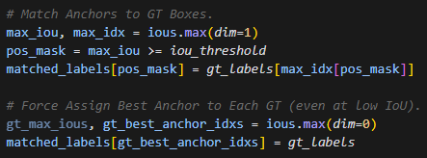
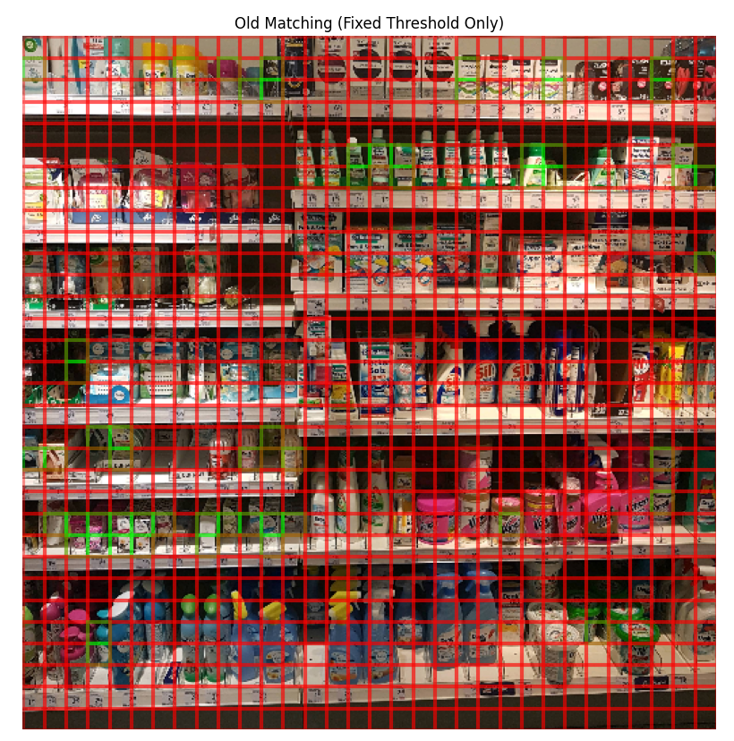
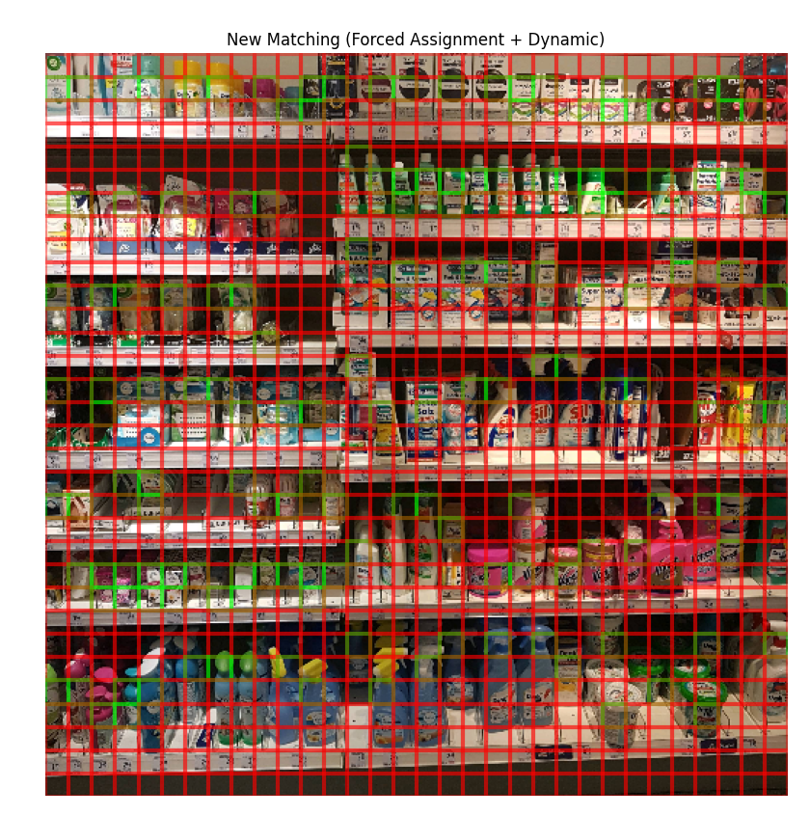

2. Improved Matching Logic
The Problem :
Anchors weren’t properly assigned to GT boxes.
Many GT boxes had no positive anchor matches.
Resulted in zero mAP / F1 even after long training runs.
Figure: Snippet of Anchor Matching Logic..
What We Changed :
Introduced IoU-base matching with tunable threshold.
Forced best-match assignment per GT box $→$ guarantees every object is represented
8
Before IoU-base matching.
After IoU-base matching.
Notes:
"
In the beginning as said previously the anchors gave us lots of issues, with them not actually getting aligned with the ground truth boxes, they were not getting assigned either,
that meant that if the model was making predictions we didn’t know if they were connecting at all with the ground truths which gave us no clear feedback to train on, which is why some of our testing metrics were completely flat and zeroed out.
To fix this we rewrote our matching logic with IoU based matching with a more tunable threshold, furthermore we actually force assigned ground truth boxes to its best anchor, even if the IoU wasn’t really high, it guaranteed that every object was represented.

Slide 9
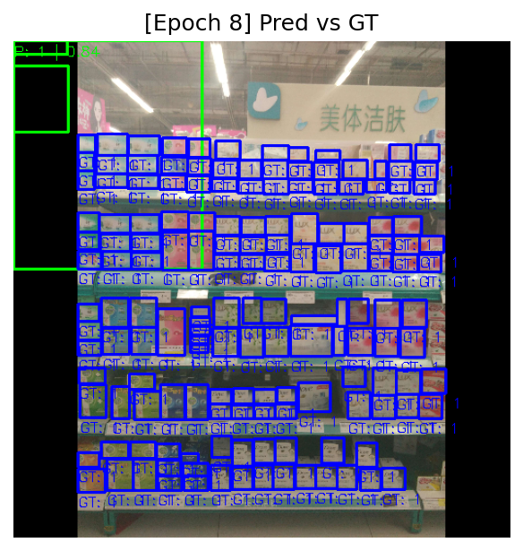
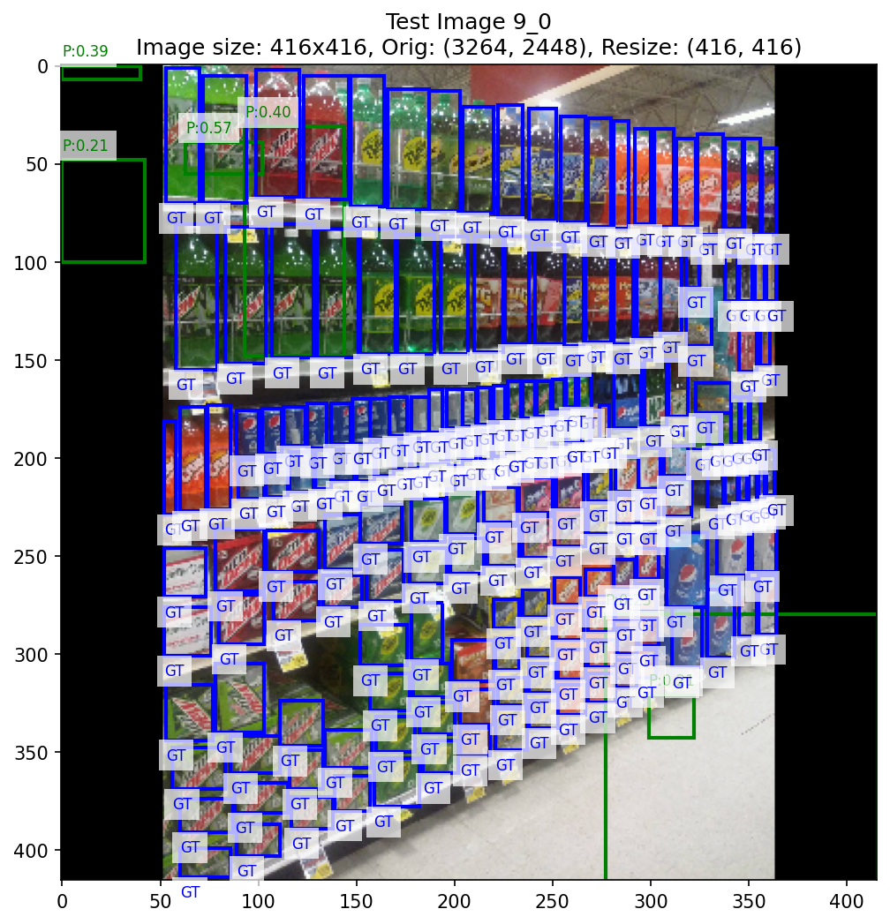

3. Box Delta Debugging
Before Fix :
Box $Δ$’s were applied without proper clamping or validation.
Causing box predictions to explode towards image edges or shrink to near-zero size.
Fixed Made :
Clamped predicted delates to safe values.
Clipped boxes to say within image boundaries.
Filtered boxes with heigh/width too small or large.
Before : Predictions Sitting on Edges & Are Too Big.
Result :
Predictions now stay within valid bounds.
Reduced false positives from massive or corrupted box shapes.
9
After : Predictions stay within more applicable size range.
Notes:
Box Deltas gave us a lot of issue, from our early visualizations we saw a lot predictions that were either making the boxes way too big or clustering on the edges of the images/
This was occurring because when we were applying our box deltas, or the adjustments we want the model to make to the predictions, that we didn’t really have any safety checks such as clamping.
To fix this we added safeguard that clamped the deltas to reasonable limits, forcing the boxes to stay within the image bounds, and filtering out any predictions that were either way too small or too massive.
This helped keep our predictions simple, and significantly reduced the noise of our predictions.

Slide 10
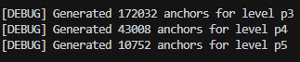
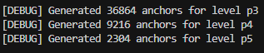

4. Memory & Batch Tuning
The Problem :
Training w/ Full Dataset + Large Batch Size $→$ CUDA Out of Memory Errors.
Anchor tuning increased total anchor count $→$ Higher Mem Load during Training.
Debugging / Testing was slow due to full-data loading.
Fixes Made :
Reduced Batch Sizes during Training in our config files.
Utilized a subset size to enable quick training / debug runs.
Controlled number of anchors per level via smarter scales + ARs.
Figure: Reduction in total anchors per level after tuning anchor scales and aspect ratios — significantly lowered memory usage and improved efficiency.
Result :
Resolved OOM Crashes.
Enable faster iterations for testing.
10
Figure: Snippet of OOM Error Message..
Notes:
At one point during training we kept both running into an issue with a CUDA out of memory errors, this was happening when we tried to train on larger datasets with large batch sizes.
From further debugging we found out that it was not only the batch size causing this, some of the anchor tunin had exploded our anchor count which made our memory usage even worse.
To fix this it was relatively simple, but overlooked, we just reduced our batch sizes and introduced a subset config to allow us to run a smaller amount of images, we also re-tuned our anchor scales and aspect ratios to limit then number of anchros per level,
this not only fixed the memory crashes but made our training much faster.

Slide 11
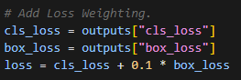
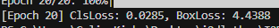

5. Loss Balancing & Scheduling Optimization
The Problem :
Classification & Box Losses were on very different scales, leading to imbalanced learning.
Model would converge too fast due to aggressive learning rate drops.
Early training was unstable – the model couldn’t learn effectively right away.
Figure : Snippet of Added Loss Weighting.
What We Changed :
Dynamic Loss Weighting $→loss=cls_{loss}+0.1 ∗box_loss$
Warmup Extended $→$ 3 Epochs for smoother ramp-up.
Gentler LR Decay. ( 0.2 $→$ 0.1 )
Loss trends across training. The baseline model stalled around a box loss of 10 — our improved setup pushed it down substantially with better learning dynamics.
Result :
Training now more stable, smoother convergence with fewer spikes.
11
Notes:
In our early stages of training too we began to notice that our cls loss and box loss were on completely different scales, box loss often being like 10 times larger. This would cause the model to over-focus on one objective and it led to a more unstable learning where it would either plateau early or fluctuate too much to properly converge.
To fix this we explicitly weighted our losses, treating classification as the main driving, and down-weighting box loss to 10%.
Further improvements were extending our warm up phase so the model could ease into training, and softening how quickly our learning rate drops, these helped createa a smoother loss curve especially for box loss which you will see in some of the following slides.

Slide 12
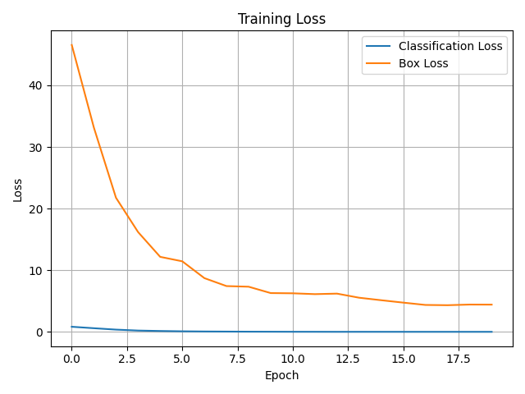
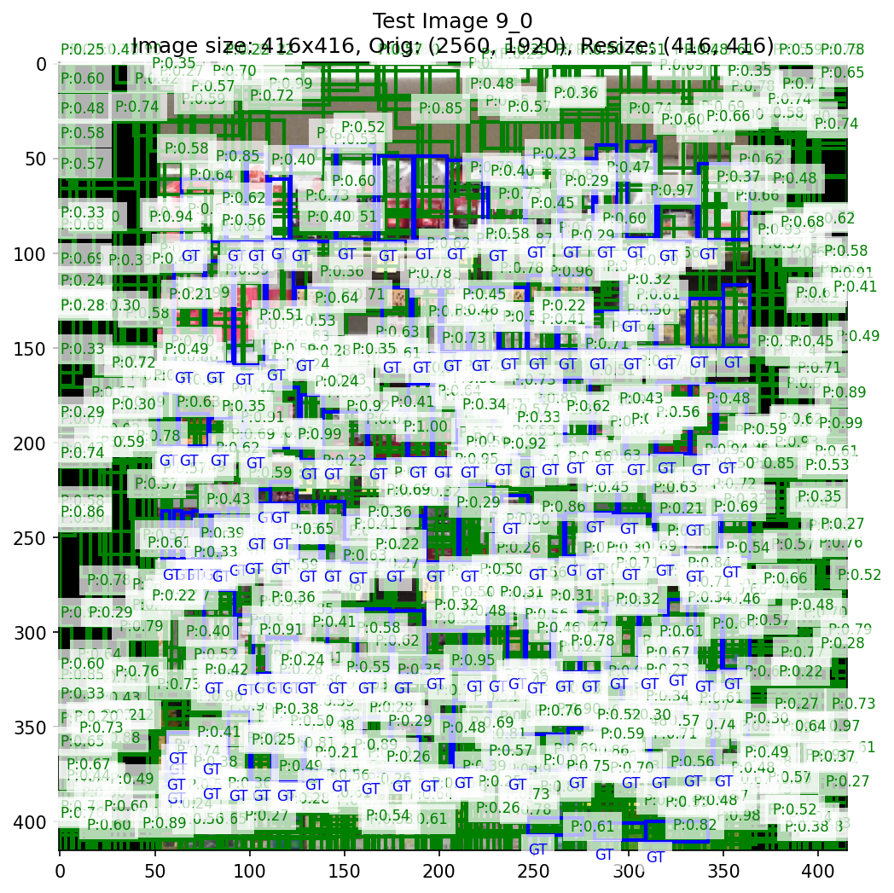
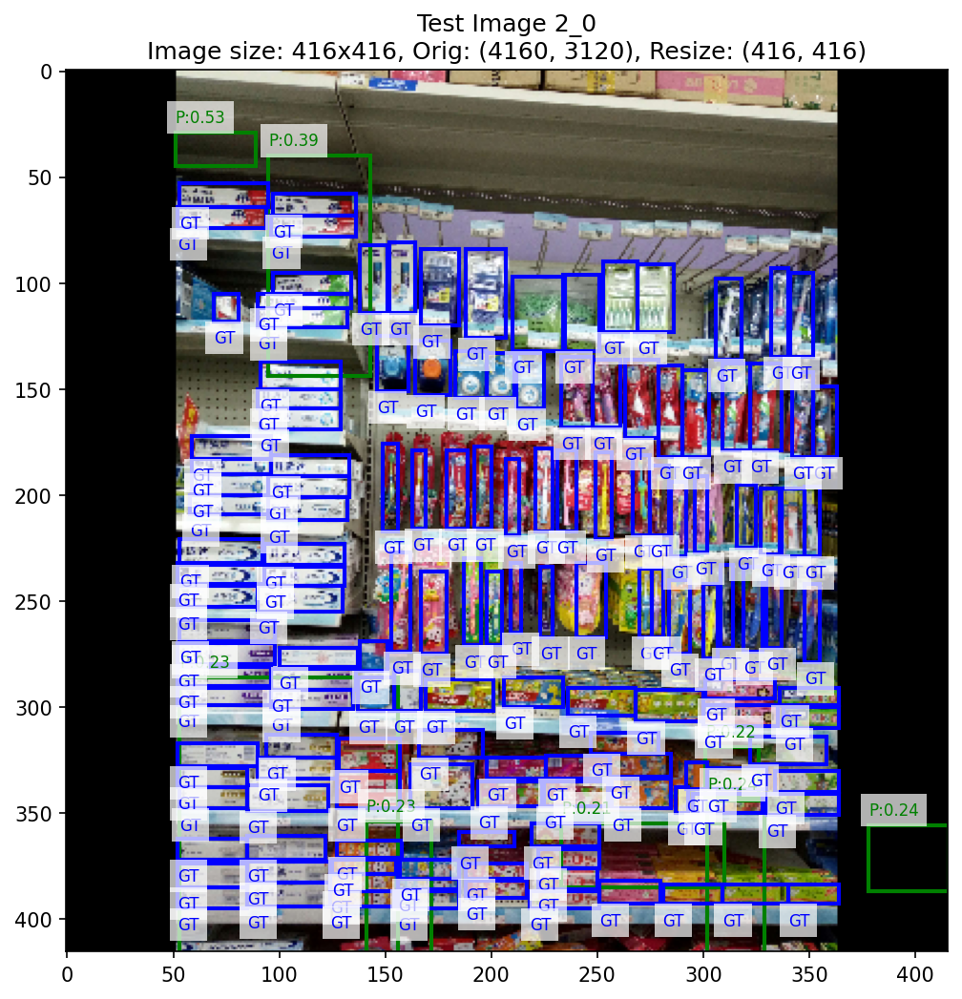
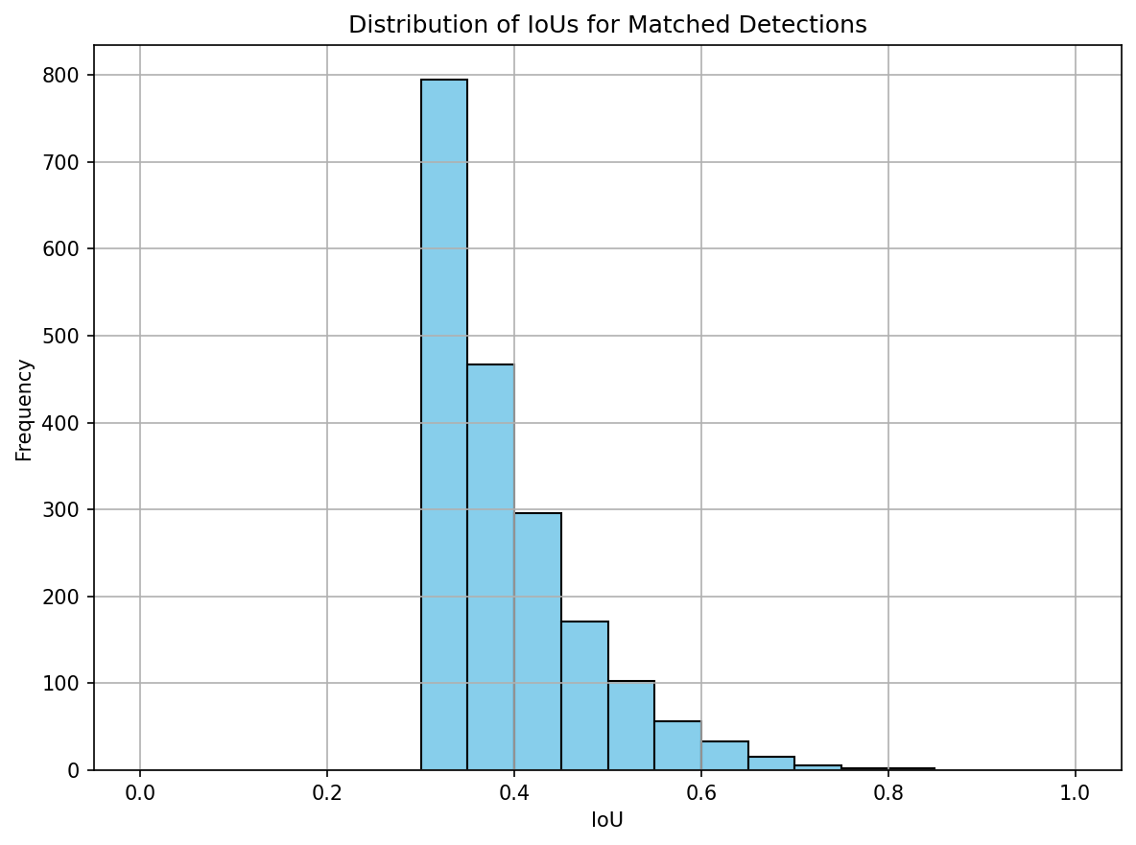
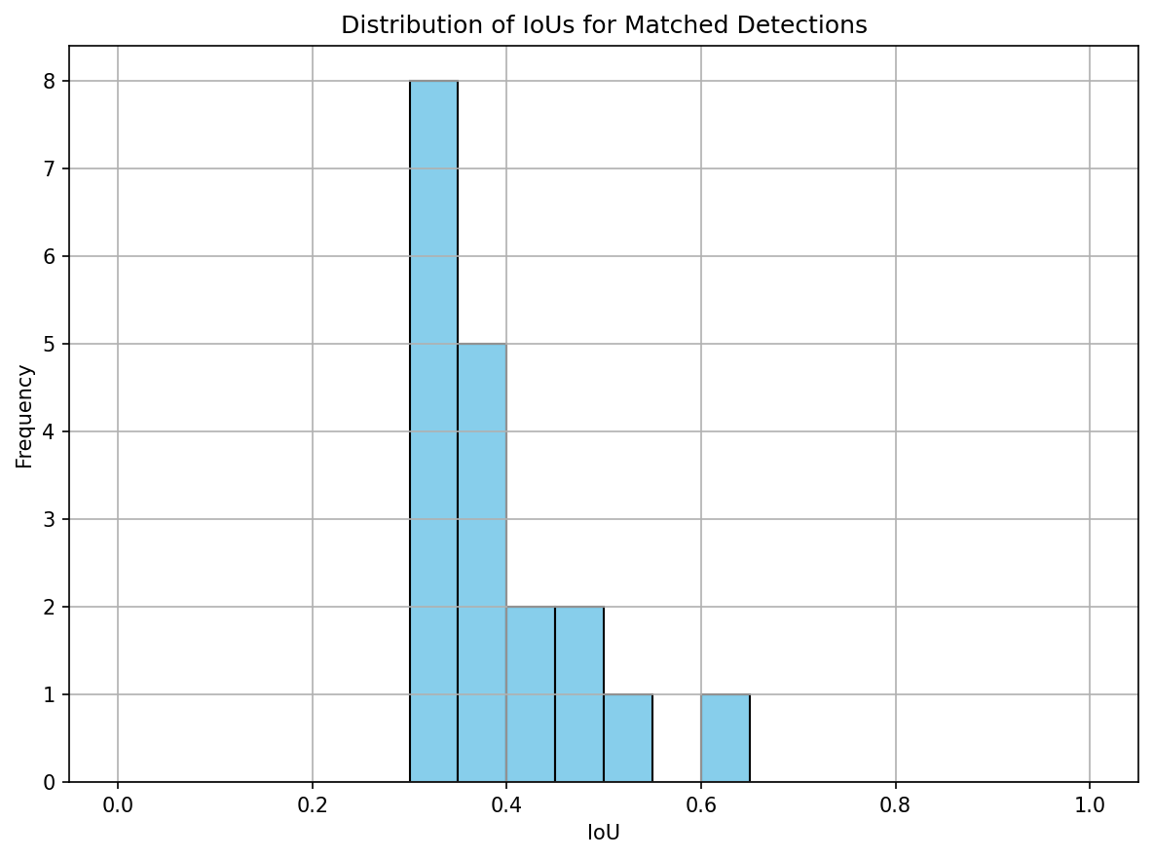
Before / After Improvements
Before Improvements
After Improvements
Before Improvements Training / Testing Behavior :
Box loss : ~9.8,
Classification loss : ~0.1
Precision : 3.5%, Recall : 13.5%, mAP : 1.4%
Although metrics seemed okay, this was misleading — the model produced 55,676 predictions for 14,439 objects, relying on quantity over quality.
These over-predictions created false positives that happened to overlap, inflating IoU and F1 without true understanding.
After Improvements Training / Testing Behavior :
Box loss improved significantly (well below 5)
Precision dropped to 2.2%, Recall to 0.1%, but this time the model only made 861 predictions.
This reflects a more conservative, high-confidence behavior — fewer detections, but closer to meaningful learning.
This is a trade-off during training: fewer, more confident predictions → eventually tuned to recall more.
12
Notes:
Before any of our fixes, the model looked okay on paper — we had 3.5% precision, 13.5% recall, and even some mAP. But when we looked closer, it was producing over 55,000 predictions for just 14,000 actual objects. Basically, it was spamming boxes hoping some would hit — and that inflated metrics like IoU and F1 without real understanding.
After our improvements, the model became way more selective — box loss dropped significantly, and even though our recall dropped, we only made 861 predictions. That means it’s more confident and less noisy. So this is the kind of trade-off you want early in tuning: fewer guesses, but better guesses.

Slide 13
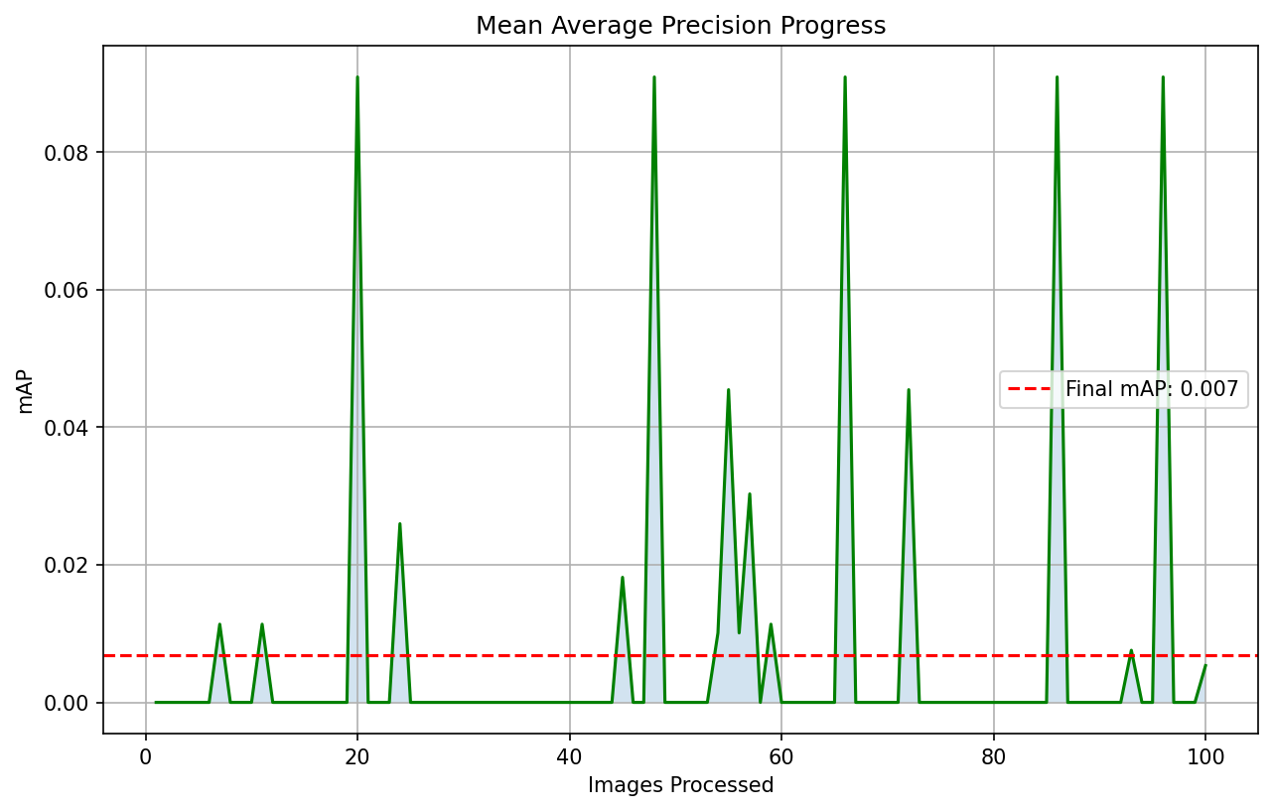
Current Model Results – ShelfVision Summary
What This Means :
Detection is working (non-zero TP), but we're still struggling with recall and false positives.
Bounding box alignment has improved (IoU ~ 0.38), but many predictions still fall below confidence or NMS thresholds.
ShelfVision now generalizes across shelf layouts — major improvement from Eval 1 (empty outputs).
Still behind fine-tuned SOTA (YOLOv5), but progress is clear.
These results form the basis for comparing with both:
YOLOv5 pretrained (COCO)
YOLOv5 fine-tuned on SKU110K
Metric | ShelfVision | Eval1
Precision | 0.0221 | 0.00
Recall | 0.0013 | 0.00
F1 Score | 0.0025 | 0.00
Avg IoU | 0.3875 | 0.00
mAP | 0.0069 | 0.00
True Positives | 19 | 0.00
False Positives | 842 | 0.00
False Negatives | 14,420 | 0.00
Figure: mAP progression over 100 images, final mAP ≈ 0.007 with high variance.
13
Notes:
This slide summarizes where our model — ShelfVision — currently stands. Compared to Eval 1, we’ve made real progress: we now get non-zero detections, with a precision of about 2% and an IoU around 0.38. That means our predicted boxes are starting to line up with the ground truths — or the actual labeled objects — even if confidence is still low.
We’re still behind state-of-the-art models like YOLOv5, but the key takeaway is that ShelfVision no longer completely fails on the test set. It’s making meaningful predictions. This forms our benchmark moving forward as we compare against both the pretrained YOLOv5 (trained on COCO) and the fine-tuned version trained specifically on SKU110K.

Slide 14
YOLOv5 (COCO Pretrained) vs. ShelfVision
Explanation :
The YoloV5 that we ran, lacks any exposure to retail shelf-style layouts and object density.
As a result, almost all detections are filtered out post-NMS or do NOT overlap with GTs.
YOLOv5 fails due to zero retail domain adaptation — ShelfVision shows early learning despite low recall.
Despite lower confidence scores, ShelfVision shows clear improvement with meaningful IoUs and non-zero mAP — proving it's learning retail-specific patterns.
Metric | YoloV5 | ShelfVision
Precision | 0.00 | 0.0221
Recall | 0.00 | 0.0013
F1 Score | 0.00 | 0.0025
Avg IoU | 0.00 | 0.3875
mAP | 0.00 | 0.0069
True Positives | 0 | 19
False Positives | 342 | 842
False Negatives | 14,885 | 14,420
Note : ShelfVision results are from early-stage training. While performance is still low, the model is beginning to learn SKU-110K-specific patterns—later epochs continue to improve mAP and reduce false positives.
14
Notes:
This comparison shows why domain adaptation matters. YOLOv5, when pretrained on COCO, has never seen dense retail shelf layouts — so it doesn’t know what to look for in SKU-110K-style images. It either predicts objects that don’t overlap with ground truth — those are the real labeled boxes — or it gets filtered out entirely during post-processing.
ShelfVision, on the other hand, while still in early stages, is at least showing some meaningful overlap. Our IoU is non-zero, mAP is beginning to rise, and we’re making progress. So even though the raw recall is low, the takeaway is that ShelfVision is already starting to adapt to the retail domain — something YOLOv5 can’t do without fine-tuning.

Slide 15
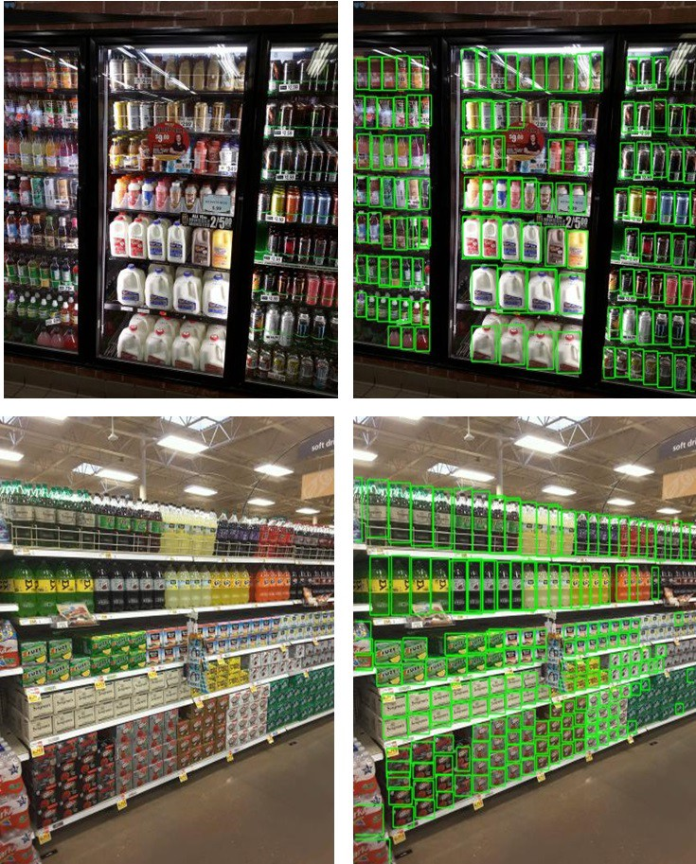
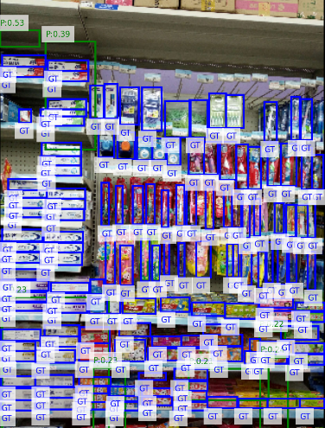
YOLOv5 (Fine-Tuned) vs. ShelfVision
Explanation :
The YOLOv5 fine-tuned greatly outperforms our ShelfVision across all metrics.
Looking at YOLO’s metrics you can tell the model is much more efficient at learning to localize and classify shelf products with strong consistency.
Metric | YoloV5 | ShelfVision
Precision | 0.00 | 0.0221
Recal | 0.00 | 0.0013
F1 Score | 0.00 | 0.0025
Avg IoU | 0.00 | 0.3875
mAP | 0.00 | 0.0069
True Positives | 0 | 19
False Positives | 342 | 842
False Negatives | 14,885 | 14,420
Predictions
Why does ShelfVision underperform?
Smaller customer architecture – Designed for faster inference & lower memory footprint.
Fewer hyperparameter optimizations.
Might not leverage multi-scale detection like YOLO’s FPN-based head.
15
Notes:
Here, we’re comparing our model to a fine-tuned version of YOLOv5 — trained specifically on the SKU-110K dataset. As you can see, YOLO dominates across all metrics. It’s learned how to localize and label retail products really effectively, and its predictions are both dense and accurate.
ShelfVision falls short because it’s a lightweight custom architecture. It's optimized for speed and lower memory use, not maximum detection power. Plus, we didn’t do nearly as much hyperparameter tuning as YOLO, and we’re not leveraging features like multi-scale detection. So while our model is improving, it’s not quite on the same level yet — and that’s expected.

Slide 16
Team Contributions
Task | Colin Kirby | Nathan Little
Model Architecture & Pipeline | 70% – Led coding of backbone, FPN, detection head, anchors | 30% – Assisted in module integration
Evaluation & Debugging | 30% – Supported validation fixes, ran tests | 70% – Focused on identifying root issues (e.g., 0 mAP)
Visualization & Coverage Tools | 60% – Built anchor/debug visualizers | 40% – Interpreted results, proposed changes
Training Tuning & Stability | 50% – Adjusted loss tracking, early stopping | 50% – Tuned config (batch size, subset, etc.)
Presentation Writing | 40% – Designed visuals and layout | 60% – Wrote improvement descriptions and analysis
16
Notes:
For this project, we divided the workload based on our strengths. Colin shined as a programmer and focused more on the architecture and core implementation — handling the backbone, detection head, and custom anchor logic — while I took care of the evaluation, debugging, and analysis. Colin also developed most of the visualization tools, and I handled a lot of the writing and metric interpretation. For training and tuning, we split responsibilities pretty evenly to troubleshoot loss behavior and improve stability. It was a very collaborative process, and each of us played a key role in pushing ShelfVision forward.

Slide 17
Conclusion & Next Steps
ShelfVision now produces valid detections with improved IoU (~0.38), a major step up from Eval 1.
Precision and Recall are still low due to confidence filtering and bounding box quality.
Fine-tuned YOLOv5 significantly outperforms our model, highlighting the gap in robustness and training scale.
Despite limited metrics, the model shows meaningful progress in generalizing to real shelf layouts.
Next Steps :
Perform deeper analysis on false positives and filtered predictions.
Explore better threshold tuning, data augmentation, and post-processing.
Begin drafting the final report — ⚠️ our team has not started it yet. ⚠️
17
Notes:
ShelfVision has come a long way since Eval 1. We now produce valid detections with significantly better bounding box alignment — our average IoU has jumped to around 0.38, which is a solid sign that the model is understanding where objects actually are. While precision and recall are still low, that's mainly because of confidence filtering and issues with borderline box predictions.
Fine-tuned YOLOv5 still clearly outperforms us — it’s trained on a much larger scale and benefits from a more robust architecture. But what we’re seeing is meaningful progress: ShelfVision is starting to generalize to real shelf layouts, even under tighter constraints.
In terms of next steps, we want to dive deeper into the false positives and see which predictions are getting filtered and why. We’re also planning to look into threshold tuning and augmentation strategies to help boost recall. And finally, we do need to start the final report — that’s something we haven’t kicked off yet, but it’s now a top priority.

